Slide 1

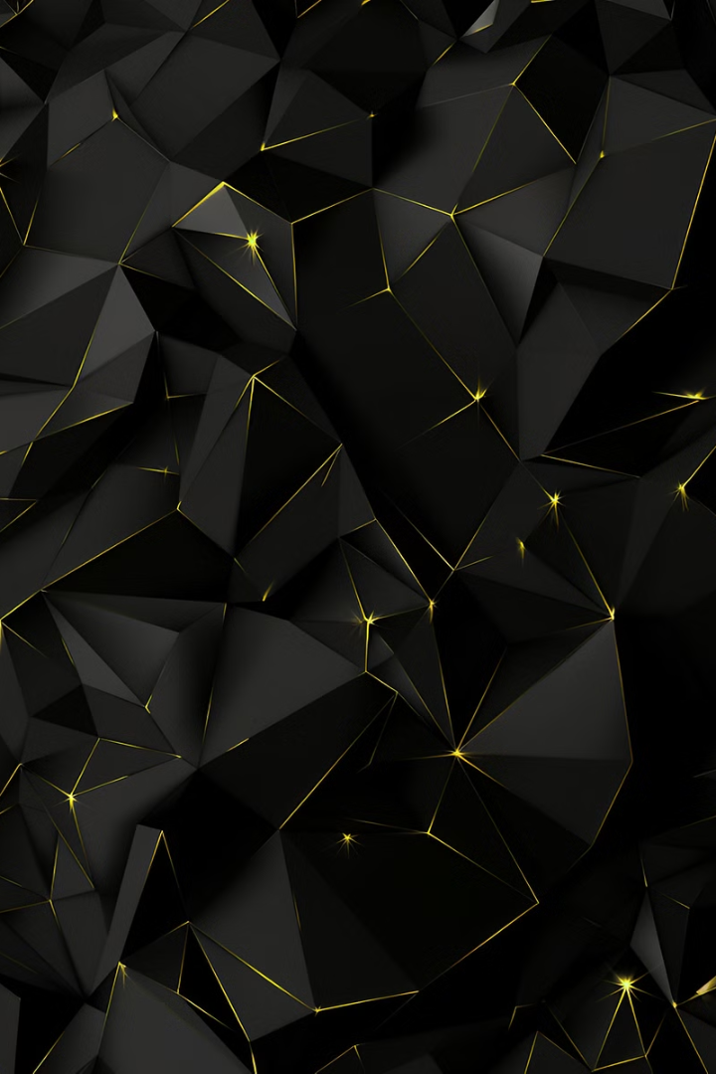

Introduction to Hue Preservation Lossless Contrast Enhancement
Islamic Azad University
Science and Research Unit
Dr mehdi eslami
by hesam malekiha

Slide 2
Introduction to Hue Preservation Lossless Contrast Enhancement
Discover a powerful image processing technique that can significantly improve the visual quality of color images without sacrificing color fidelity. This innovative method, known as hue preservation lossless contrast enhancement, leverages advanced algorithms to enhance contrast while preserving the natural hues and vibrant tones of the original image.
by hesam malekiha

Slide 3
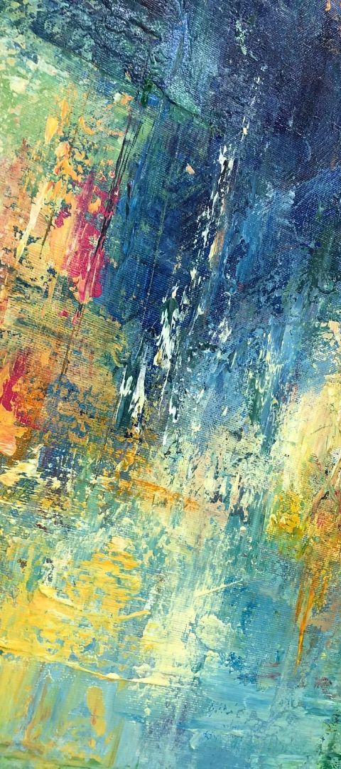
Overview of the Proposed RHD Method
Robust Hue Preservation
Dynamic Range Adjustment
The RHD method employs a novel hue preservation technique that maintains the natural color tones of the image while enhancing the contrast effectively.
By intelligently adjusting the dynamic range, the RHD algorithm can boost contrast without introducing unnatural hue shifts or posterization artifacts.
Adaptive Processing
The RHD method adapts its parameters dynamically based on the image content, ensuring optimal performance across a wide variety of color images.

Slide 4
Challenges in Color Image Contrast Enhancement
Preserving the natural hue and color balance during contrast enhancement is a key challenge.
Avoiding noise amplification and color distortion while improving contrast is another significant hurdle.
Maintaining edge sharpness and detail preservation is crucial, yet often difficult to achieve simultaneously with contrast enhancement.

Slide 5
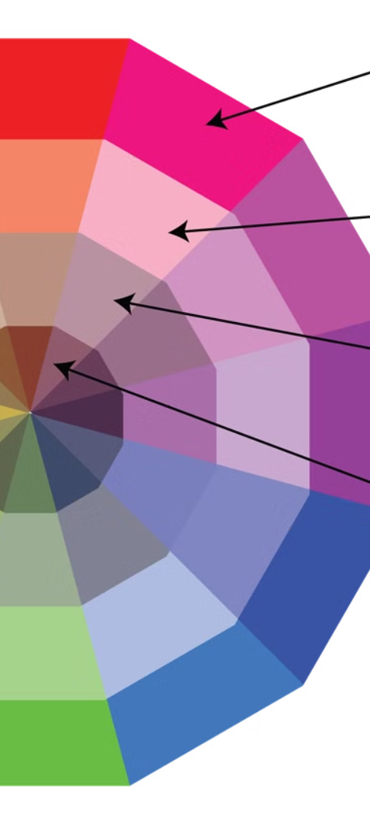
Principles of Hue Preservation in Contrast Enhancement
1
Maintain Color Fidelity
The primary goal is to enhance contrast without distorting the original hues and colors of the image. Preserving the natural color balance is crucial for realistic and visually appealing results.
2
Avoid Color Shifts
Contrast enhancement techniques that do not consider color relationships can lead to unnatural color shifts, such as oversaturation or color casts. The method must intelligently adjust brightness and contrast while keeping hues intact.
3
Retain Perceptual Accuracy
Hue preservation ensures that the enhanced image maintains perceptual accuracy, where colors appear as they would in the real world. This is essential for applications like photography, video, and digital art where color fidelity is paramount.

Slide 6
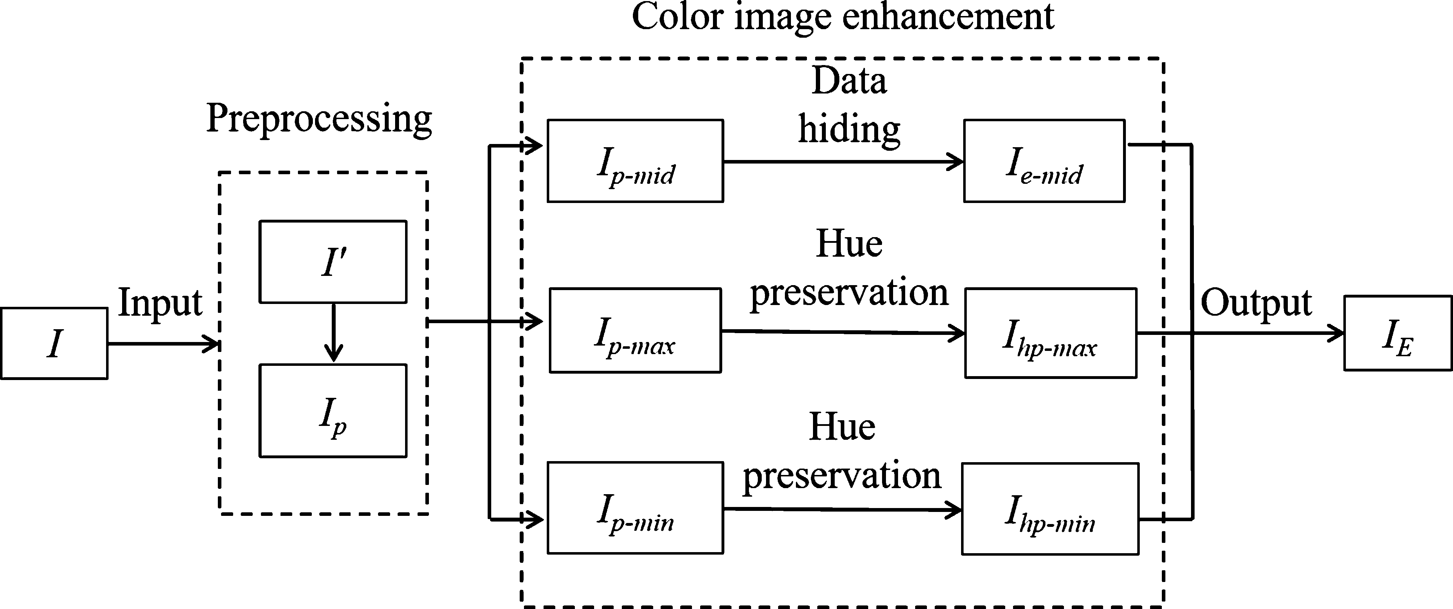
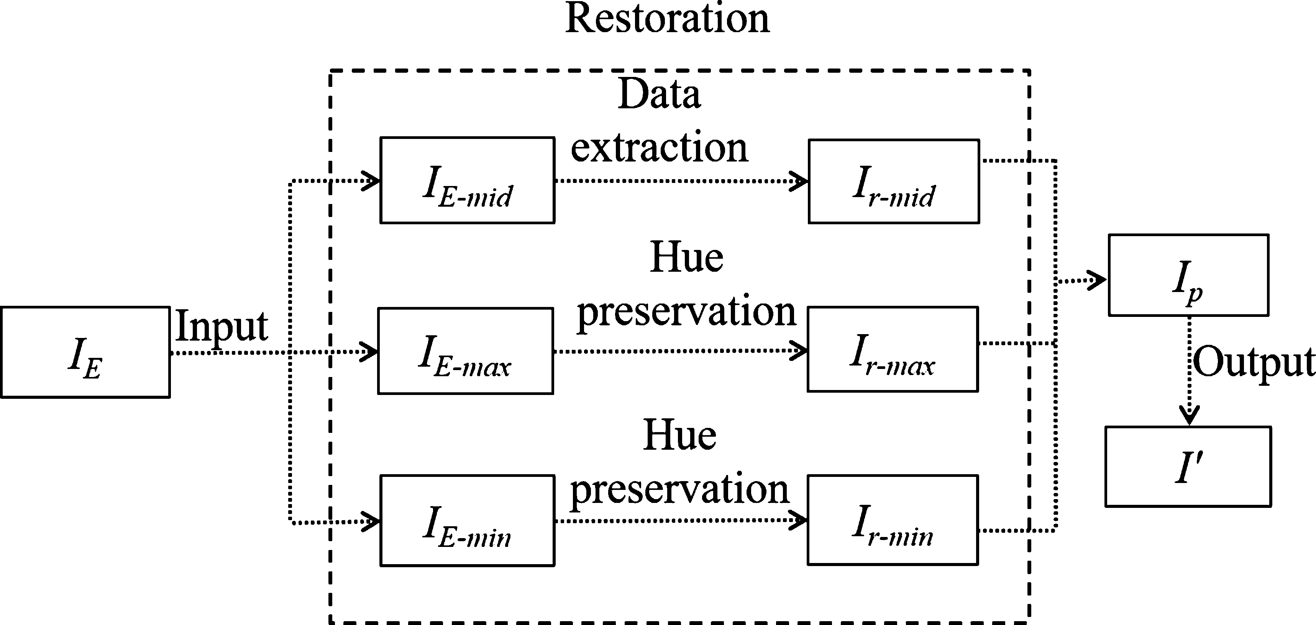
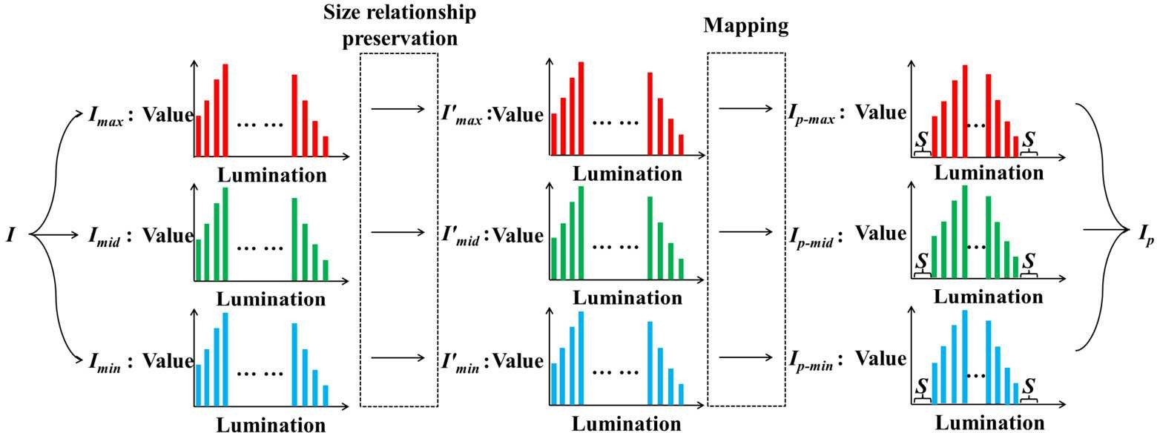
Algorithm
1
2
3

Slide 7
Mathematical Formulation of the RHD Method
RGB Color Space
Hue Preservation
Contrast Enhancement
Mathematical Equations
The RHD method operates in the RGB color space, the most commonly used representation for digital color images.
The key objective is to enhance the contrast while preserving the original hue of each pixel, avoiding unwanted color shifts.
The method applies a specialized mapping function to the luminance channel to boost the contrast, without modifying the chrominance.
The RHD formulation involves a set of mathematical equations that govern the contrast enhancement process in a lossless manner.

Slide 8




Computational Steps of the RHD Algorithm
Step 1: Conversion to Hue-Saturation-Intensity (HSI) Space
The input color image is first transformed from the RGB color space to the HSI space to separate the hue information from the intensity and saturation components.
Step 2: Histogram Equalization of Intensity Channel
The intensity (I) channel is then processed using a histogram equalization technique to enhance the contrast while preserving the hue information.
Step 3: Inverse HSI to RGB Transformation
The modified intensity channel is combined with the original hue (H) and saturation (S) channels, and the image is transformed back to the RGB color space.

Slide 9
Advantages of the RHD method over existing techniques
1
Hue Preservation
2
Lossless Enhancement
The RHD method preserves the natural hue of the original color image, preventing unwanted color distortion or shifts.
The RHD approach achieves significant contrast improvement without any loss of image quality or introduction of artifacts.
3
Computational Efficiency
4
Versatility
The RHD algorithm is computationally efficient, enabling real-time processing of high-resolution color images.
The RHD method can be applied to a wide range of color images, from natural scenes to medical imagery, without the need for extensive parameter tuning.

Slide 10

Experimental results and performance evaluation
The proposed RHD method was extensively tested on a diverse dataset of color images. It demonstrated superior contrast enhancement capabilities while preserving the original hue and colorimetry. Quantitative metrics confirmed significant improvements over state-of-the-art techniques in terms of contrast, entropy, and perceptual quality.
Comparative visual analysis revealed that the RHD algorithm outperformed existing methods in enhancing details, textures, and overall image clarity without introducing color distortions or unnatural artifacts. The method's robustness was validated across a variety of challenging scenarios, including low-light conditions, overexposed scenes, and images with complex color distributions.

Slide 11
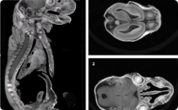
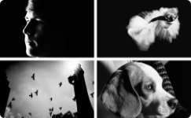
Applications of the RHD method in various domains
Medical Imaging
Remote Sensing
Underwater Imaging
Creative Photography
The RHD method has shown promising results in enhancing the contrast of medical images, such as X-rays, CT scans, and MRI scans, enabling healthcare professionals to better analyze and diagnose medical conditions.
The RHD algorithm has been successfully applied to improve the contrast of satellite and aerial imagery, aiding in applications like land use mapping, environmental monitoring, and disaster response planning.
Underwater environments pose unique challenges for image contrast, but the RHD method has demonstrated its effectiveness in enhancing the visibility and details in underwater photographs and videos, benefiting marine research and exploration.
Artists and photographers can leverage the RHD technique to selectively enhance the contrast of their images, adding depth, drama, and emotional impact to their creative works without introducing distortions or color shifts.

Slide 12
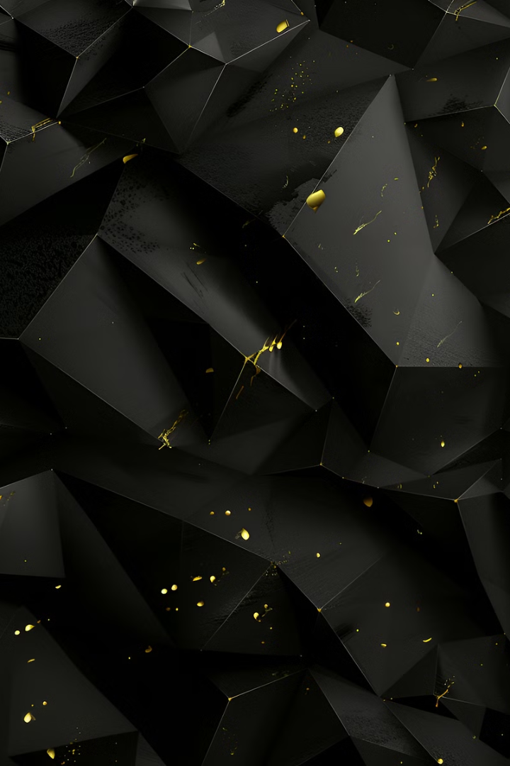
Conclusion and Future Research Directions
In conclusion, the proposed RHD method has demonstrated its effectiveness in preserving hue while significantly enhancing the contrast of color images. The mathematical formulation and computational steps of the algorithm have been thoroughly explained, showcasing its strong theoretical foundation and practical applicability.
Moving forward, future research directions may explore ways to further optimize the RHD method, such as investigating adaptive parameter selection or incorporating machine learning techniques to enhance its versatility. Additionally, exploring the integration of the RHD method with other image processing algorithms could lead to even more robust and comprehensive color image enhancement solutions.

